Slide 1
Bribery over social networks
Abhinav Sen 20CS10003

Slide 2
Basics of voting
N candidates. M voters
Each voter has a preference profile which is an ordering over candidates
Candidates are scored based on a scoring rule applied on the preference profiles. Winner decided based on some condition on scores
Tiebreakers decided based on some preconceived rule

Slide 3
Basics of Bribery
Each voter has an associated cost to change one preference profile into another. These costs can be given by a function from preference profiles to R
Need more concise representations of bribery. Can define bribery costs in terms of cost to swap voters (Swap bribery), or cost to shift a voter to some amount (shift bribery)
Shift bribery can be defined by functions from [m-1] to R

Slide 4
Research Gaps
Most existing research only deals with bribery at an individual level. Does not consider the inter-relationship of voters
Consider this, would you rather bribe a difficult voter with a lot of influence on others or an easy to bribe voter with no influence?
This problem cannot be answered with conventional formulations of the bribery problem
We model the voters in the form of a social network.

Slide 5
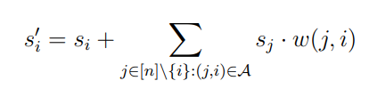
Our problem Definition
In normal shift bribery, the shift amount is just a 1 to 1 function of cost. The goal is to minimise cost to achieve some result.
Here, it is we can model the shift amount in terms of the ‘impact’ bribing voter i as well as all of the voters they are influenced by
Here si represents the ‘impact’ of our bribery individually on voter i, and w(j, i) * sj represents the impact of voter j on voter i.

Slide 6
Our problem Definition
Note that our problem statement allows us to freely model varying weights of influence between voters.
The ‘impact’ we have on every voter si has some associated cost given by a set of M cost functions.
Unlike in actual shift bribery, the s vector here does not represent anything concrete. It is a latent variable that is caused by our bribery, that then causes shifts in preference profiles.
In shift bribery, shifts are directly modelled as a function of costs. Defining it like this makes makes it possible to how to difficult it is to sway individual voters as well.

Slide 7

Problem Definition
Given a set of candidates Given a set of voters and their network Given a set of preference profiles Given a set of cost functions Given a preferred candidate c Given a voting rule
Given a budget b
Is it possible to make c win by spending a value under budget. Ie.

Slide 8
Some Results
For a complete Graph with all path weights 1, problem is polynomial time solvable with linear cost functions.
(Analogous to a situation where you have a small group of people where everyone knows everyone else, are highly influenced by each other and there is no ‘most’ influential person)

Slide 9
Algorithm
Just bribe 1 person. Choose the person with the lowest coefficient
Does not work for non linear cost functions
For the majority voting rule, We know the amount to bribe
For the plurality voting rule, a little more complicated

Slide 10
Some Results
For a path Graph with all path weights 1, problem is polynomial time solvable with identical linear cost functions under the majority voting rule.
(Analogous to a situation where voters are voting one after another, and each voter can only see the next person’s vote and can be influenced.)

Slide 11
Algorithm
It is intuitive to greedily bribe the person ahead whenever possible (since si can be shifted forward with the cost for identical linear cost functions), and to not at all bribe a voter when not needed
Does not work for non identical or non linear cost functions
Formal proof for the statements present in report
Now we can generate a dynamic programming solution where we can either choose to bribe a voter i or not that runs in polynomial time (might not be the most optimal)

Slide 12
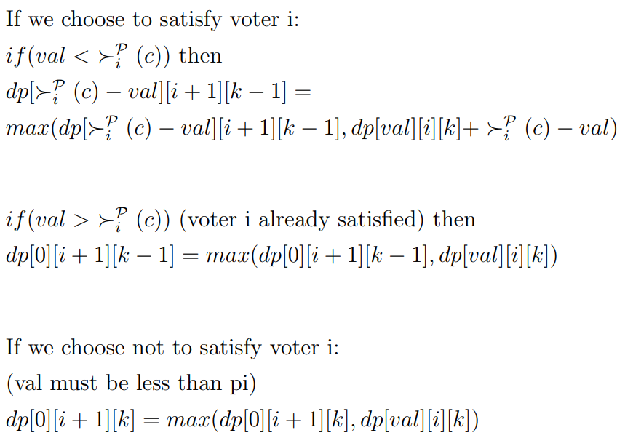
Algorithm
define dp[val][i][k] to be the minimum budget used until voter i (not included) such that there are k more voters left to achieve majority, and the value of si is val

Slide 13
Algorithm
Val cannot exceed m for any instance of the problem, which makes the dp of polynomial size. The dp can be filled by iterating in decreasing order of k, increasing order of i and decreasing order of val
The algorithm essentially takes the maximum of 2 possibilities, which have been formally proven to definitely be in the set of optimally feasible possibilities.

Slide 14
What about the general problem?

Slide 15
Probably NP hard
Strong parallels to proven NP hard problems, especially for the majority rule
Attempted to reduce the problem under the majority voting rule to the problem under the plurality voting rule. Did not work because of the way our shift briberies are defined.
Attempted to reduce maximal feasible subsystem problem to our problem under the majority rule. However, this won’t work since the linear equations in our problem is a specialised version of the MFS problem. Unsure if this specialised version is also NP hard (with a constraint on the number of equations, number of variables, and satisfiabilty)

